Slide 1
Unit 3
Lecture 3

Slide 2
Introduction:
• Computer software, or simply software, is a collection of data or computer instructions that tell the computer how to work.
• The computer hardware cannot perform any task on its own. It needs to be instructed about the tasks to be performed.
Software is a set of programs that instructs the computer about the tasks to be performed.
• Software tells the computer how the tasks are to be performed; hardware carries out these tasks.
Different sets of software can be loaded on the same hardware to perform different kinds of tasks.
Types of Software: Software can be broadly classified in two categories:
System Software, and
Application Software.

Slide 3
System software provides the basic functions that are performed by the computer.
It is necessary for the functioning of a computer.
Application software is used by the users to perform specific tasks.
The user may choose the appropriate application software, for performing a specific task, which provides the desired functionality.
The system software interacts with hardware at one end and with application software at the other end.
The application software interacts with the system software and the users of the computer.
Figure below shows the hierarchy of software, hardware and users.

Slide 4
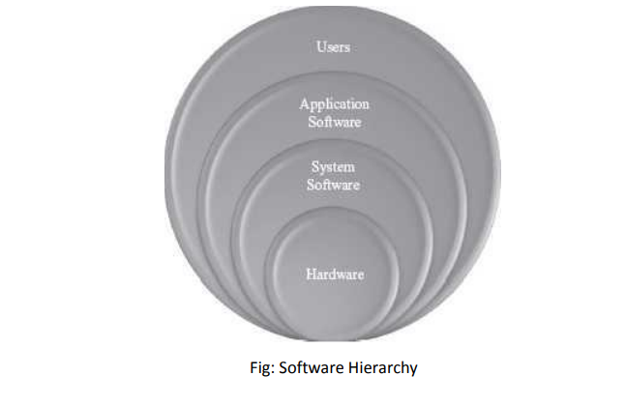

Slide 5
System Software:
• System software is a type of computer program that is designed to run a computer's hardware and application programs.
If we think of the computer system as a layered model, the system software is the interface between the hardware and user applications.
• System software provides basic functionality to the computer and is required for the working of computer itself.
• The user of computer does not need to be aware about the functioning of system software, while using the computer.
• For example, when you buy a computer, the system software would also include different device drivers.
Exqmples: Windows, DOS,PC Tools etc.

Slide 6
The purposes of the system software are:
❖ To provide basic functionality to computer,
❖ To control computer hardware, and
❖ To act as an interface between user, application software and computer hardware.
Types:
System Management Software (OS, Operating Environments)
System Software Utilities

Slide 7
Application Software :
The software that a user uses for accomplishing a specific task is the application software.
Application software may be a single program or a set of programs. A set of programs that are written for a specific purpose and provide the required functionality is called software package.
Application software is written for different kinds of applications—graphics, word processors, media players, database applications, telecommunication, accounting purposes etc. Some examples of application software packages are as follows:
• Word Processing Software: For writing letter, reports, documents etc. (e.g. MS-WORD).
• Image Processing Software: For assisting in drawing and manipulating graphics (e.g. Adobe Photoshop).
• Accounting Software: For assisting in accounting information, salary, tax returns (Tally software)

Slide 8
Spreadsheet Software: Used for creating budget, tables etc. (e.g. MS-Excel).
• Presentation Software: To make presentations, slide shows (e.g. MS-PowerPoint)
• CAD/CAM Software: To assist in architectural design. (e.g. AutoCAD, Autodesk)
• Geographic Information Systems: It captures, stores, analyzes, manages, and presents data, images and maps that are linked to different locations. (e.g. ArcGIS)
• Web Browser Software: To access the World Wide Web to search documents, sounds, images etc. (e.g. Internet Explorer, Chrome).

Slide 9
Software Acquisition:
Different kinds of software are made available for use to users in different ways.
The user may have to purchase the software, can download for free from the Internet, or can get it bundled along with the hardware.
Nowadays with the advent of Cloud computing, many application softwires are also available on the cloud for use through the Internet, e.g. Google Docs.

